Slide 1




Applied Electronics: VAM
Team 14
Yuan Kai
Rebecca Li
Tingting Brill
Shandlie Jean-Baptiste

Slide 2

Table of contents
1
2
3
Problem Summary
Algorithm Implementation
Production Scenarios

Slide 3



1
Problem Summary
Production planning in different countries for semiconductor chips

Slide 4

Optimizing Chip Production
Applied Electronics provides semiconductor chips from 6 plants around the world and each plant has a different production capacity and cost of production. The demand for chips can change globally. The company ships the chips to meet the demand in different regions and incurs import duties and shipping costs based on the origin and destination of the shipment.
The objective is to create a production schedule with the lowest total cost (production cost + duties + shipping costs).
80-90% of the plant capacity will be utilized
A team has created a plan, but the cost ($78.445 million) could be lower
Suggested approach: Utilize Vogel's approximation method.

Slide 5
2
Algorithm Implementation
Explanatory Description for Algorithm VAM

Slide 6
Declare variables
Matrix c
Vector s & d
Matrix x
The cost matrix, cij is the unit cost of supplier i producing products then distributing to demander j
s, the vector of supplier capacities
d, the vector of distributor demands
The quantity matrix to be optimized, an original zeros matrix

Slide 7

Declare variables
Handling the difference between total supply and total demand
Our team understand that VAM is not a ‘real’ optimization algorithm but an efficient method to find an acceptable, feasible solution to a transportation optimization problem.

Slide 8
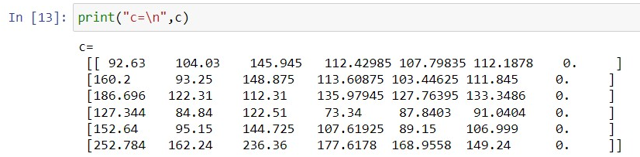
Declare variables
Handling the difference between total supply and total demand
One solution is to add a void s/d to the vectors of actual supplies and demands and assign 0s to the void elements in the c matrix. By doing this, we will not change the total cost function to be optimized but will change the opportunity cost vectors in iterations.

Slide 9
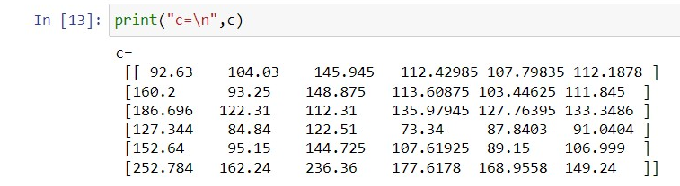
Declare variables
Handling the difference between total supply and total demand
Alternatively, we can use the original declared variables since VAM is not real optimization and therefore does not require a standard form of linear optimization problems to function.

Slide 10




Declare variables
Handling the difference between total supply and total demand
A void d seems more reasonable since it will help the algorithm decide how to handle the quantity of extra supplies.
Nevertheless, since VAM is not proper optimization, which data preparation method is better can be obscure.
We tried both ways of data preparation and found that with different capacity constraints, using a void d in the algorithm can result in either better or worse outcomes than not using a void d.

Slide 11
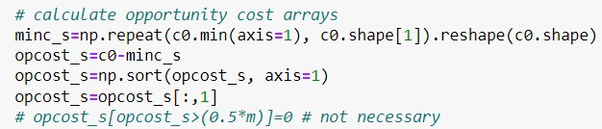

Optimization iterations
Step 1, calculate opportunity costs
Extract the minimum of each columns in matrix c to get a vector
Duplicate the vector to create a mincost matrix
Calculate c-mincost, and sort each column
Extract the second row of c-mincost, which should be the opportunity cost vector of d
Likewise we can calculate the opportunity cost vector of s

Slide 12
Optimization iterations
Step 2, find the index of x to be optimized
Find the maximum in two opportunity cost vectors
Use the index of maximum in the oc vectors to locate rows and columns should be considered in one iteration
Find the minimum element of c matrix in the rows and columns of interest, and extract the location of such element
Step 3, update the iterables (x,s,d)

Slide 13

Optimization iterations
Step 4, exclude the optimized rows/columns in later iterations
Define M which is an infinite large compared to any element in the original c matrix.
Use M to replace rows and columns where s and d has been optimized to 0 in previous iterations.
Since M is very large, it should not mess up the opportunity cost calculations unless there is only one row/column left to be optimized.
When there is only one row/column left to be optimized, introducing M will result in strange opportunity cost vectors, but should find the correct indexes of the element to be optimized.

Slide 14

Optimization iterations
M | c12 | c13 | c14
M | c22 | c23 | c24
M | c32 | c33 | c34
M | c42 | c43 | c44
M | M | M | c14
M | M | M | c24
M | M | M | c34
M | M | M | c44
The opportunity cost of each row remains unchanged since M is very large
Opportunity cost of the optimized column will be 0, and will not change the max cost and the indexes to be optimized
The largest opportunity cost will be M-min(ci4)
Locating the max opportunity cost is the same as locating the min(ci4)
The indexes to be optimized found by the algorithm should be identical to ones found by regular VAM

Slide 15
3 Production
Three Difference Production Scenarios

Slide 16
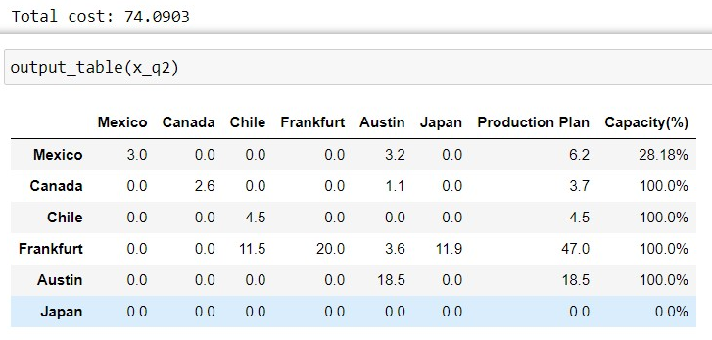
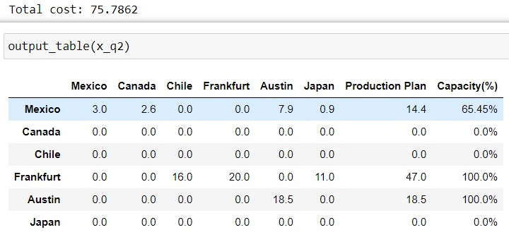




Optimization iterations
Optimized results-Q2
No void demand
With a void demand

Slide 17
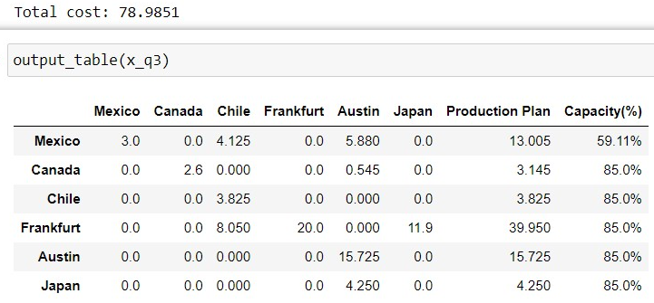
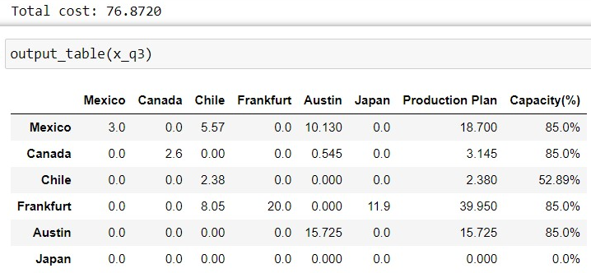

Optimization iterations
Optimized results-Q3 (85% capacity)
No void demand
With a void demand

Slide 18
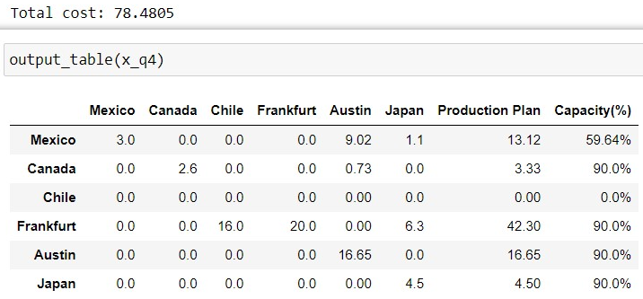
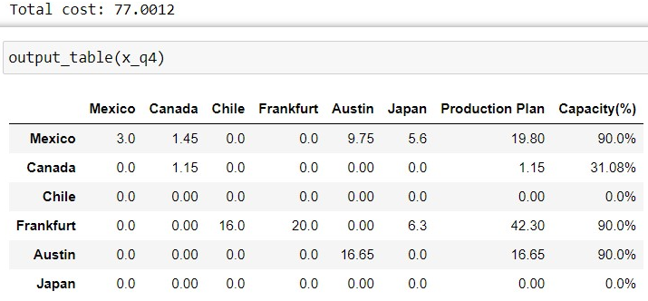

Optimization iterations
Optimized results-Q4 (90% capacity and exclude Chile)
No void demand
With a void demand

Slide 19



Thank You!

